Slide 1

A Numerical Approach To The Quantum Tunneling Concept Of Alpha Decay Using The Secant Method
° Group Participant 1: Kabir Anais
° Group Participant 2: Kemmouni Younes
° Group Participant 3: Abdelhadi Mohammed Bouziani
° Group Participant 4: Mebrouki Sofia
° Group Participant 5: Kettab Hala
° Group Participant 6: Ouarest Sifeallah
° Group Participant 7: Belmiloud Mohammed Saad

Slide 2

WHAT IS QUANTUM TUNNELLING?
Quantum tunneling :
is a counterintuitive quantum mechanical
phenomenon where particles
can penetrate through potential energy
barriers bigger then their own kinetic energy ,
opposing to the laws of classical mechanics.
This behavior arises from the wave-particle
duality of quantum particles, allowing them to exhibit wave-like properties.
Wave-particle duality :
This means that particles can behave as discrete particles with
definite positions and momentum , or as waves spread out
over space. The specific behavior observed depends on the
experimental conditions For example : a drop of water has a
shape and it’s position can be known , on that scale we can
define it as a particle , but if we take a portion of water and
disturb its stability we would clearly see it moving forming waves ,
in this case water ( the same nature) has acted like a particle and a wave

Slide 3


The probability of tunneling :
depends on several factors, including the mass of the particle, the height and width of the potential barrier, and the particle's energy. Lower-mass particles, such as electrons or protons, are more likely to tunnel through narrow barriers ,and for that the wave function which is the probability of finding the particle anywhere in a volume span represented by it displaying the probabilities all around the barrier
IT IS NOT THAT EASY TO COMPREHAND RIGHT ? …
To make it more concrete, let‘s mention one of most famous examples explaining this concept :
Imagine two electrons: one is free to move, while the other is fixed in place. Due to their negative charges, they repel each other. If you push the free electron towards the fixed one, classically, it would bounce back like a ball hitting a wall. However, quantum mechanics allows for a different outcome, the free electron behaving as a wave , can penetrate the potential barrier created by the repulsive force , meaning the existence of the probability of the electron to appear on the other side of the barrier , even if the energy isn’t enough to overcome the repultion , the probability is never 0 !
EXAMPLE 1 :

Slide 4
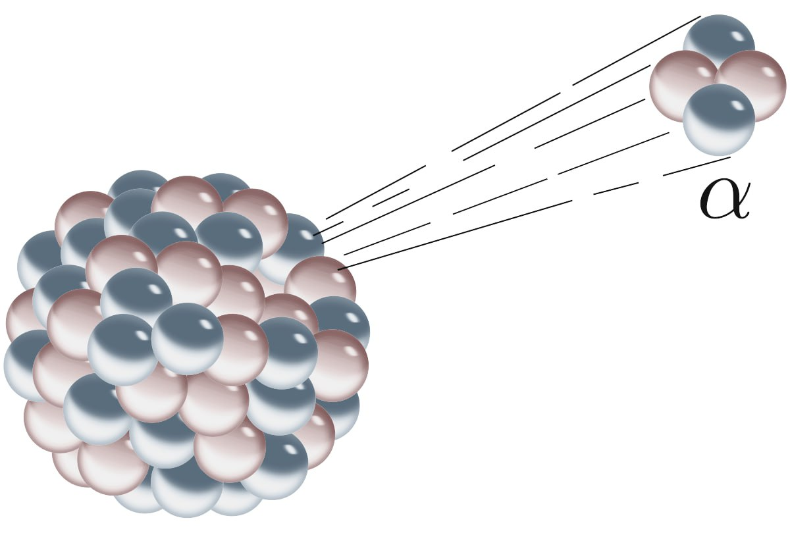
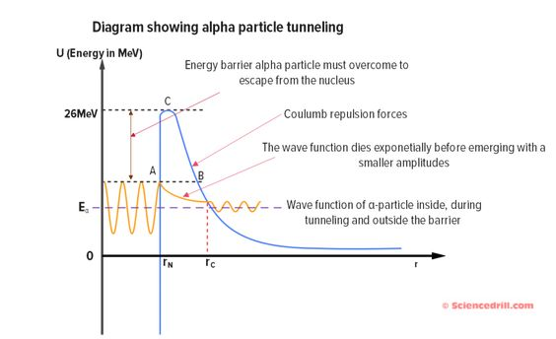
THE ALPHA DECAY :
All these concepts, from quantum tunneling *
to wave-particle duality, converge to illuminate the
mechanism behind alpha decay. By understanding how
particles can tunnel through potential barriers,
we can grasp how an alpha particle, composed
of two protons and two neutrons, can escape the nucleus
, even though it lacks the classical energy to do so
. This quantum mechanical process, rooted in the
wave-like nature of particles,
is the fundamental driving force behind alpha decay.
Certain unstable atoms persist to exist for long periods
of time and don’t decay instantaneously , this fact means
there must be some sort of barrier that is in place and doesn’t allow the alpha particle to escape from the nucleous , so for it to escape to the outside of it , it should overcome the forces of the other neucleons, so when the alpha particle moves along a small space in the neucleous with a kinetic energy less than the attraction energy the alpha particle is bound by a large negative potential due to the strong nuclear force Beyond the radius of the nucleus, Coulomb's potential due to the positive charge of the nucleus becomes the dominant potential.

Slide 5
This results in a great potential barrier that blocks particles from escaping the nucleus, and deflects outside particles from entering the nucleus This point where particles are blocked inwards, and the other point where particles are deflected outwards, are known as the classical turning points. According to classical theory, these turning points strictly prohibit any particle from exitting or entering the nucleus. However, quantum mechanics tells us that there is indeed a non-zero probability that a particle is able to escape the nucleus By formulating and approximating the wave function of an alpha particle inside an alpha-decaying nucleus, we're able to study quantitatively the behavior of the decay process. We can determine the decay constant of the nucleus in terms of the energy released by the decay process, and thus solve for this energy numerically by matching the decay constant with experimental values

Slide 6
THEORETICAL REVIEW
01
SECANT METHOD : definition , relation to alpha decay

Slide 7
THEORETICAL REVIEW
1_ DEFINITION : The secant method is a numerical method used to find the root of a function (when f(x) = 0). It works by iteratively approximating the value of the root using secant lines. Two values, x1 and x2, that will be chosen in a close interval around our potential root, are picked such that f(x1)>0 and f(x2)<0. A secant line will be drawn between these two points, and will cross the x-axis at the point x3. we then get the formula x3 = x2 - f(x2)(x2-x1)/f(x2)-f(x1)
and we repeat the process until we find a root (xi) for which f(xi) is close to zero. The secant method can be viewed as an approximation of Newton's method, which requires the derivative of the function. In Newton's method, the tangent line to the function at a point is used to approximate the root. In the secant method, the secant line, which approximates the tangent line, is used instead. This avoids the need to compute the derivative, making it a practical choice when derivatives are difficult (may be null) or computationally expensive to obtain so since the secant method is derived from newtons method , lets start from newtons method to get there :

Slide 8
_ we know that the tangent equation is :
Y=f(x0)+f’(x0)(x-x0)
At y=0 (when it crosses the x axis)
0= f(x0)+f’(x0)(x-x0)
By deviding on f’(x)(excluding the case that we mentioned earlier of deviding on zero )
0= f(x0)/ f’(x0)+( x-x0)
f(x0)/ f’(x0)= -( x-x0)
f(x0)/ f’(x0)= -x+x0
f(x0)/ f’(x0)-x0=-x
by choosing two values of x itll become :
-f(xn)/ f’(xn)+x_(n)=x_(n+1)
_ Newtons method allows you to determine the next x point you can use to get your desired approximation , now lets use this formula to get the secant approximation by applying what we informed you about in the former definition , changing f’(x0) by its approximation (the secants equations)
So we would get :
F’(xn)=(f(xn+1)-f(xn))/(xn+1-xn)
We implement this into the last equation to obtain the secant formula

Slide 9
2_ RELATION TO ALPHA DECAY :
We can use Schrodinger’s time independent equation and compare the wave function’s magnitude at the classical turning points of the nucleus to determine the probability of the alpha particle tunneling out of the nucleus and thus, deduce the decay constant of the nucleus as a function of the energy of the alpha decay process.
By equating this formula with experimental results, we are able to solve for the energy numerically and also deduce the difference in mass between the mother and child nuclei.

Slide 10

ALGORITHM
02
SECANT METHOD : FLOWCHART , EXPLANATION , CODE

Slide 11
ALGORITHM
1_ FLOWCHART :
Choosing x1,x2,max I,E_0 ,var xnew
I=0 ; I=I+1
Yes
No
Calculate f(x1),f(x2)
I<= max I
xNew =x1(f(x1)f(x-x0)/(f(x1)-f(x0))
The root is xnew
No
Yes
X0=x1 || x1=x0
F(xnew) - E_0=0
The new root is xnew

Slide 12
3_ THE EXPLANATION :
The flow chart presented in the previous slide , shows how the algorithm of the secant method functions in which we have to choose to starting points defining the interval of guess to find the root , followed by the choice of max iterations wanted and the value of the tolerance we need in our calculations , afterwards the iteration counter starts for each I that is different from Imax chosen , the counter will continue accordignly with the number of times we are implementing in the secant equation under the second if condition related to the tolarence in which : when the difference between the function and the tolerance is null , meaning they are equal , the calculation stops and the loop would be broken , with x new calculated in the secant equation designated as the solution , if it is not the case,the loop continues narrowing down the difference until it reaches the null difference , if the opposite results are obtained , the loop will break once I=Imax automatically announcing the latest xnew to be the root (close approximation).
Advantages of the Secant Method
1° Faster Convergence: Compared to linear methods like the bisection method, the secant method often exhibits faster convergence rates, typically superlinear.
2° Derivative-Free: This method does not require the calculation of the function's derivative, making it suitable for functions where derivatives are complex or unavailable.
3° Efficient Function Evaluations: Each iteration of the secant method typically requires only one function evaluation, unlike Newton's method, which requires two

Slide 13
3_c o d e :
function [result1, result2, terms] = apply(f, x0, x1, stop, domain) % Initialize the variables result1 = x1 result2 = x0 terms = 0 if nargin < 5. domain = [-Inf, Inf] if nargin < 4, stop = @(w, x, y, z) false; end end % If either of the two guesses provided is already a root, then just return that as the result if f(x0) == 0, result1 = x0; result2 = x0; return; end if f(x1) == 0, result1 = x1; result2 = x1; return; end
% If we hit a floating point equilibrium then the denominator becomes 0 and causes an error % We stop iterating since all further iterates will be identical anyways and we will never get a better approximation if x1 == x0, return; end % If the last guess produces a zero, it is a root if f(x1) == 0, result1 = x1; result2 = x1; return; end % Even if the guesses are not equal, we may hit a floating point contraction in the function outputs
% In that case, we add a small regularization term to avoid problems in the denominator
% We may also have two guesses that achieve a flat secant, in most cases the algorithm is just not suitable for these cases, % but it may be accounted for by this method epsilon = 0 if f(x1) == f(x0), epsilon = 1e-6 * f(x1); end % Find the next iteration of the approximation using the secant formula result1 = x1 - f(x1) * (x1 - x0) / (f(x1) - f(x0) + epsilon); x0 = x1; x1 = result1; result2 = x0; terms = terms + 1; end end

Slide 14
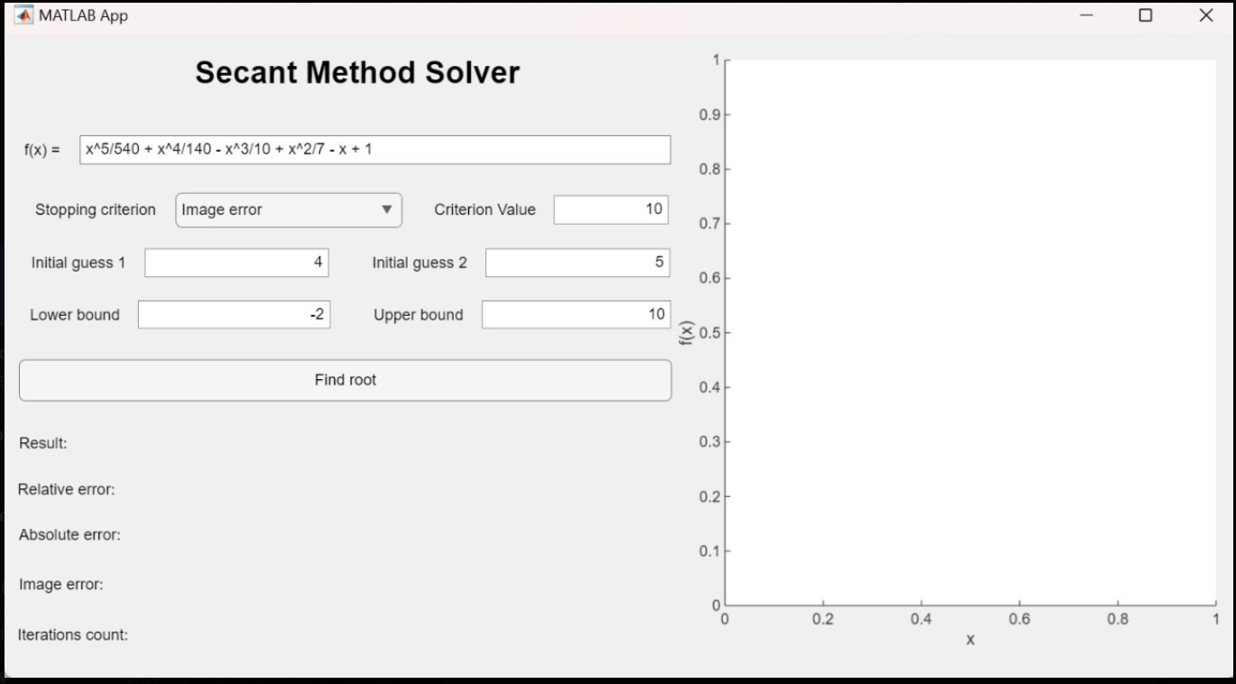
3_c o d e :
SECANT TERMS:
function [stop] = stop_terms(max)
% Stop after calculating a maximum number of iteration terms
stop = @(result, img, terms, diff) terms >= max;
end
SECANT CONVERGENCE :
function [stop]=stop_converge (tolerance)
%stop when the difference between te last two approximations is within a tolerance value
stop@=(result,imge,terms,diff)abs(diff)<=tolerance;
End
SECANT METHOD ERROR:
Function[stop]=stop_relative(tolerance)
% Stop when the relative error between the last two approximations is within a tolerance value
stop = @(result, img, terms, diff) abs(diff / result) <= tolerance;
end
ITS GUI :

Slide 15
MATLAB CODE
03
Our implementation

Slide 16
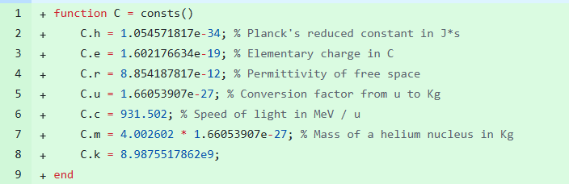
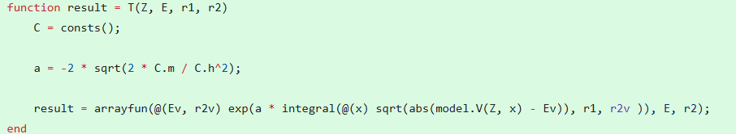
MATLAB CODE
;

Slide 17
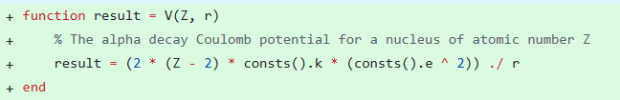
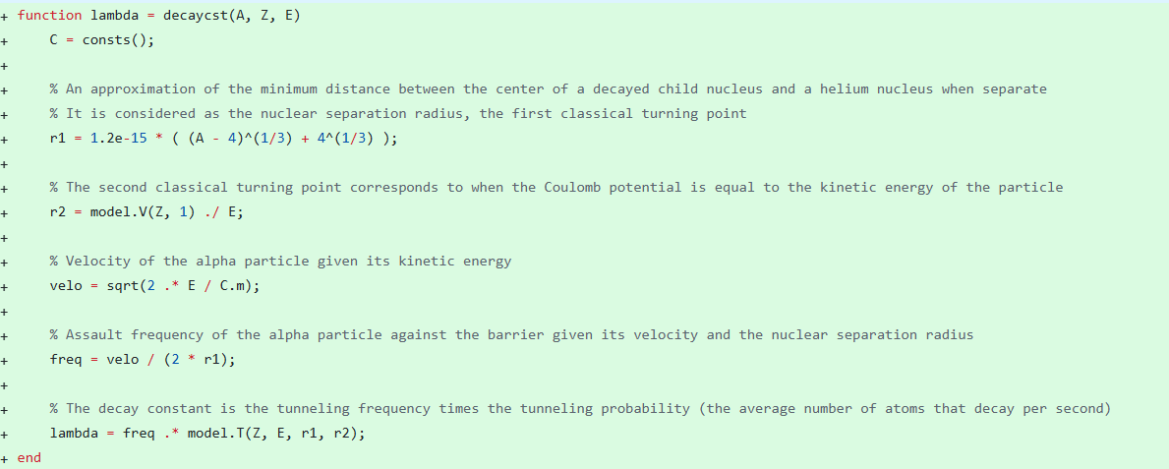
.

Slide 18
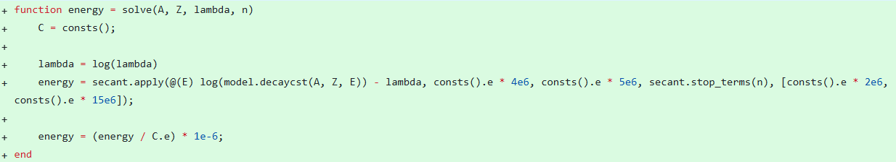
.
We have develoepd this MATLAB application to solve numerically for a function’s roots by implementing the secant method
Our application allows us to calculate the energy of the alpha decay process knowing the atomic and mass numbers of the corresponding nucleus and its half life

Slide 19
G U I
04
The interface to use our project

Slide 20
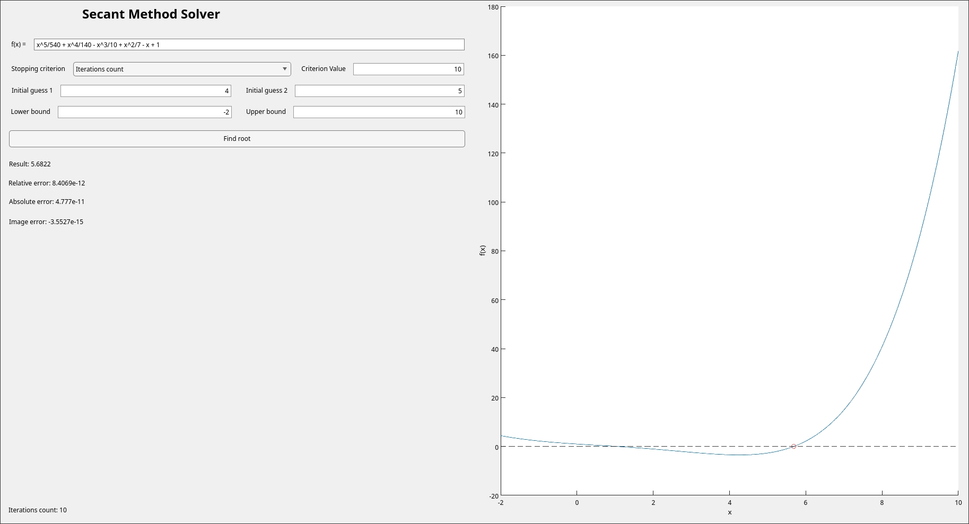
G U I
.

Slide 21
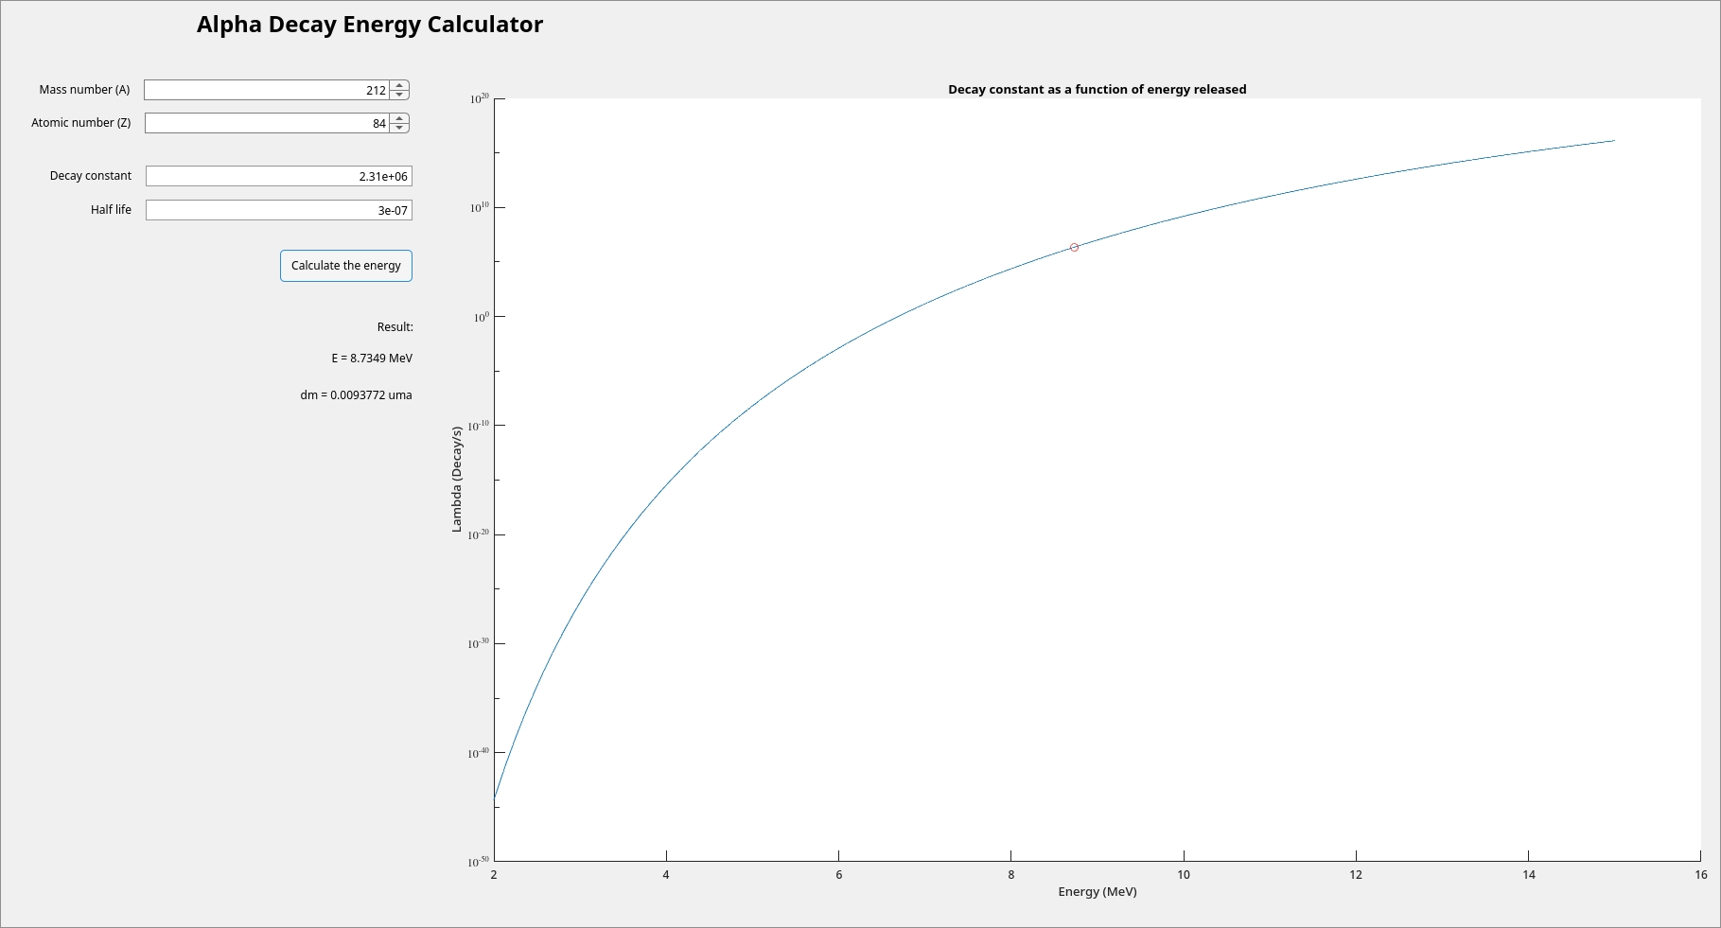

Slide 22
THE RELATION BETWEEN IT AND THE NANO WORLD
05
Applications of the secant numerical method

Slide 23
THE RELATION BETWEEN IT AND THE NANO WORLD
The Role of the Secant Method in Nanotechnology :
Its efficiency and accuracy make it invaluable for simulating and optimizing nanomaterials and devices.
Quantum Mechanics Simulations
Solving the Schrödinger Equation:
In quantum mechanics, the Schrödinger equation describes the behavior of quantum systems. The secant method can be employed to determine the energy eigenvalues and eigenfunctions of these systems, providing insights into the quantum nature of matter at the nanoscale.
Calculating Electronic Band Structures:
The electronic band structure of a material dictates its electrical and optical properties. The secant method aids in calculating these band structures, enabling the design of novel electronic and optoelectronic devices.
Molecular Dynamics Simulations
Optimizing Potential Energy Surfaces:
Molecular dynamics simulations involve calculating the forces between atoms and molecules. The secant method is instrumental in optimizing the potential energy surface, a crucial step in accurate simulations of nanomaterials and their properties.
Device Modeling and Simulation
Simulating Transport Properties:
The Boltzmann Transport Equation, which describes the transport of charge carriers in nanodevices, can be solved using the secant method. This enables the simulation of the electrical and thermal properties of nanoscale devices.
Optimizing Device Performance: By simulating the performance of nanodevices, researchers can identify optimal design parameters and materials. The secant method aids in exploring the design space efficiently and finding the best solutions.

Slide 24


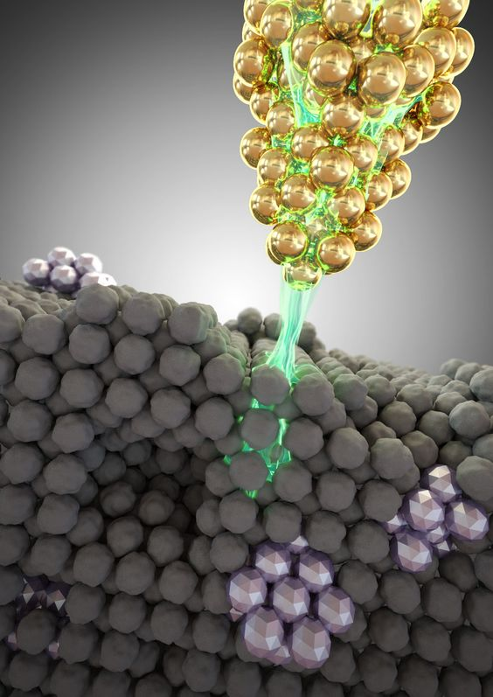
QUANTUM TUNNELING AND NANO TECHNOLOGY :
1. Scanning Tunneling Microscopy (STM):
In an STM, a sharp metal tip is brought very close to a surface.
A voltage is applied, causing electrons to tunnel through the gap between the tip and the surface.
By measuring the tunneling current, scientists can create detailed images of surfaces at the atomic level.
2. Quantum Dot Devices:
Quantum dots are tiny semiconductor particles that exhibit quantum mechanical properties.
Quantum tunneling enables electrons to move between quantum dots, allowing for the creation of devices like quantum do
t lasers and solar cells.
3. Single-Electron Transistors:
These devices rely on quantum tunneling to
control the flow of
individual electrons. By precisely controlling
the potential barriers,
it's possible to manipulate the movement of
electrons at the single-particle level.
4. Nanoelectronics:
Quantum tunneling effects are crucial in the development of nanoscale electronic devices, such as quantum computers and
spintronic devices.
These devices exploit the unique properties of quantum mechanics to achieve unprecedented performance and efficiency.
In essence, quantum tunneling is a cornerstone of nanotechnology, enabling the creation of innovative devices and materials with
extraordinary properties.

Slide 25
THANK YOU for your attention

